Slide 1
FLIGHT PRICE PREDICTION PROJECT
Submitted by:
Yogesh.C.Mudliar

Slide 2
Problem Statement
Anyone who has booked a flight ticket knows how unexpectedly the prices vary. The cheapest available ticket on a given flight gets more and less expensive over time. This usually happens as an attempt to maximize revenue based on
Time of purchase patterns (making sure last-minute purchases are expensive)
Keeping the flight as full as they want it (raising prices on a flight which is filling up in order to reduce sales and hold back inventory for those expensive last-minute expensive purchases)
We have to work on a project where you collect data of flight fares with other features and work to make a model to predict fares of flights.

Slide 3
Exploratory data analysis
Defining the question
First I define the problem statmente
Collecting the data
Cleaning the data
-Removing major errors, duplicates, and outliers
-Removing unwanted data points
-Bringing structure to your data
-Filling in major gaps
Analyzing the data
Sharing your results

Slide 4
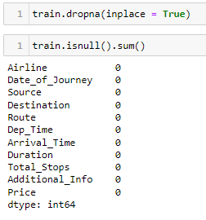
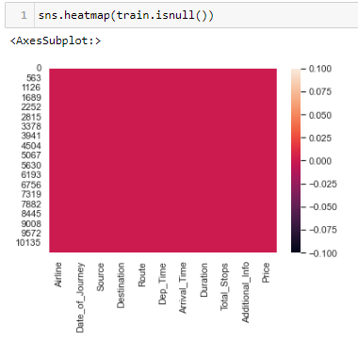
Removed all null values

Slide 5
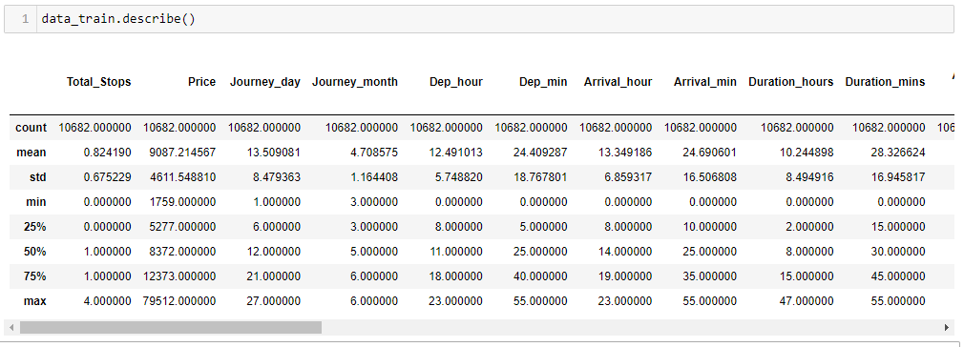
Described dataset
Our data is very much clean and ready for ML models

Slide 6
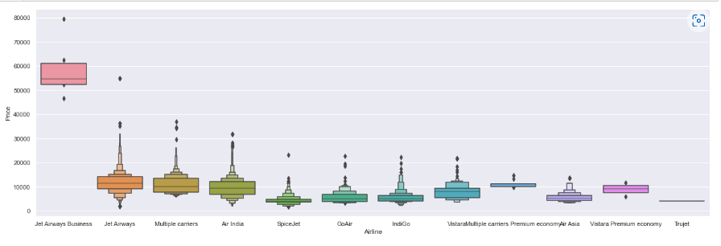
From graph we can see that Jet Airways Business have the highest Price. Apart from the first Airline almost all are having similar median

Slide 7
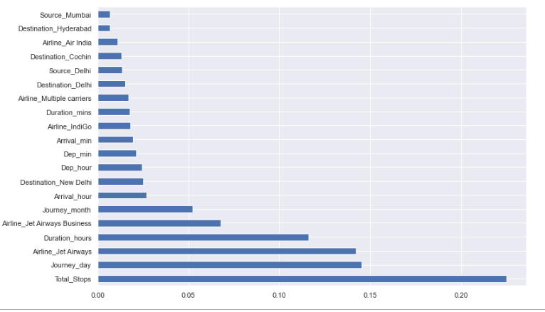
plot graph of feature importance for better visualization

Slide 8
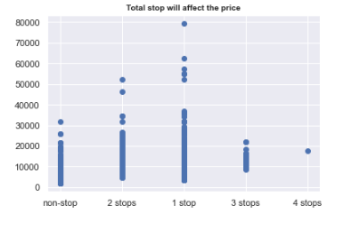
Total stops will affect the price

Slide 9
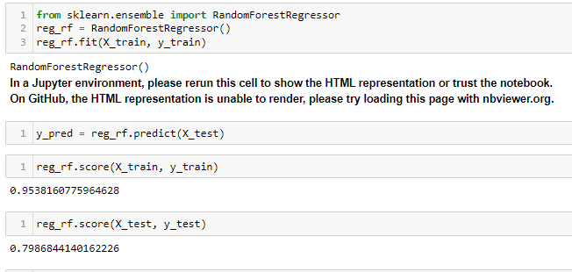
Applying machine learning and finding the results

Slide 10
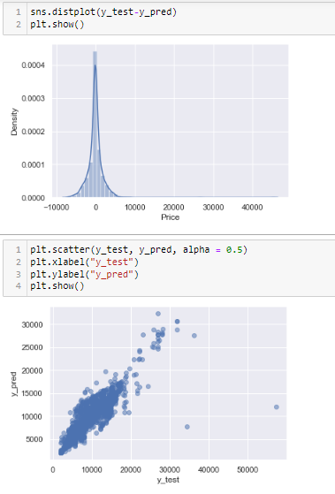
We can see the plot between y test and prediction

Slide 11
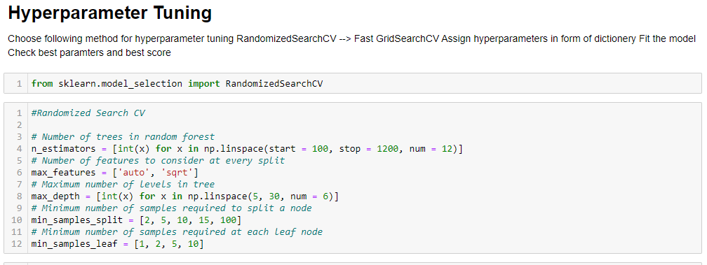
For tuning our model we used Hyperparameter

Slide 12
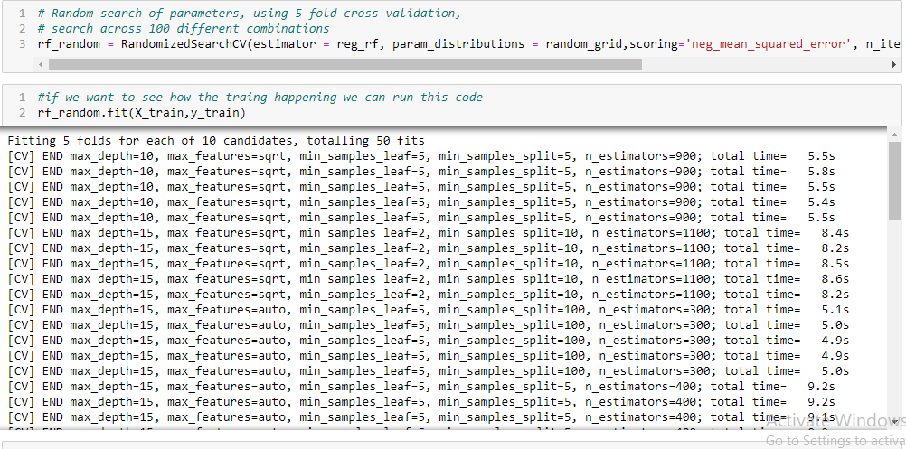
Random search of parameters, using 5 fold cross validation, search across 100 different combinations:

Slide 13
CONCLUSION
I find out the price of Flight price with the available independent variables
I find out which variables are important to predict the price of variable by plotting countplot
I fined which variables are important to predict the price of variable
For tuning our model we used Hyperparameter.
Random search of parameters, using 5 fold cross validation, search across 100 different combinations.

Slide 14


